Slide 1
SAL M’DJAREB
The 1st Review network in algeria

Slide 2
TABLE OF CONTENT
Go to
Prototype website
STARTUP INFORMATION
Business Description
Vision
Mission
Strategic Objectifs
Benefits
BUSINESS MODEL
Business Model Canvas
Category of business
Business process illustration
MARKETING STRATEGY
Market Analysis
Our services
Marketing and promotional strategy
Pricing Strategy
Sales Strategy
https://sal-mdjareb.web.app/

Slide 3
STARTUP INFORMATION

Slide 4

Business Description
SAL MDJAREB is an Algerian social network platform based on a crowdsourcing system that enables users to share their experiences and exchange their opinions about any local business's product or service.
This online platform is destined for both large public users and local businesses.
Users can access any local business’s profile and read and write reviews on any product or service they are interested in .Users can also evaluate any product and service according to a set of predefined criteria related to the product or service.
customers reviews will provide p an objective point of view on whether the organization supplied a product according to the specifications and expectations. Customer feedback provides an early warning about potential quality problems, effectively identifies risks or opportunities, generates the inputs for improvement, and initiates the necessary corrective actions.
Notes:
SM is a social network platform that enable users to share their experience and exchange their opinions about local business product and service quality through review notation system.this platform tends to stand as barometer of quality that users put

Slide 5
Business Description
On other hand, Any local business can claim their standard profile page and engage with their reviewers who would feed them with valuable feedbacks that help them understand customers' needs, anticipate their expectations, and eventually improve the quality of their offering.
The local offering will be categorized into multiple business activities, each activity contains businesses that have the same offer. The consumers will leave a comment and provide a rating of up to 5 stars. The platform will calculate the average of the cumulative individual scores that consumers provide and match the average score from 1 to 5 to a scale of excellency from “excellent” to “bad”.
The criteria of the quality for each business offer will be carefully selected by experts in each business activity field. each offer could have a bunch of criteria by which the consumer builds his judgment.

Slide 6
VISION
SAL MDJAREB’s aims to stand as a third party and an independent reference of quality that helps contributors (consumers and businesses) reach a ground of understanding that would ultimately improve the quality of the local offering on a continual basis.
SAL MDJAREB will empower consumers and businesses to connect through genuine feedback , based on consumers’ experience about any local offering.
it will help build a community of trust and credibility between the algerian consumers and the local businesses in order to regain trust in the local offering.
Notes:
We want to help businesses collect reviews to engage with their customers, fix problems, and achieve success by improving their services. We also want to help consumers learn about businesses so that they can make informed decisions when buying products and services. These things are only possible with customer feedback.

Slide 7
Mission
Our mission is to provide an online platform where both consumers and businesses can build an environment of trust and credibility with the aim to implement a system of continual improvement for the quality of the local offering.

Slide 8
Strategic Objectives
Build a community of trusted reviews between business and consumers
To stand as a reference for the quality of products and services offered by local businesses.
Drive mobile /web engagement by Making SAL MDJARB more useful for everyday consumers needs like shopping
Increase Awareness of SAL MDJAREB amongst consumers and businesses

Slide 9
BENEFITS
Continual improvement of the quality of the local offering;
Regain trust of the algerian consumers in the local offering;
Create an atmosphere of positive interaction between consumers and businesses based on the genuine feedback that consumers offer;
Improve the competitivity of local offering in comparison with the foreign offering;
Help users discover local businesses;
Large database of high quality reviews allows users to make informed decisions;
Helps businesses attract new customers with high purchase intent

Slide 10
BUSINESS MODEL

Slide 11
BUSINESS MODEL CANVAS
Key Partners
Content Contributors (Active reviewers)
Search Engines
Key Activities
Ads and products selling
Shared experiences
Raise brand Awareness
Grow the Platform
Customer services support
Value Proposition
For Businesses
Exposer and visibility
Increase traffic
Genuin Feedback
Improved revenues
Meet Expectations
For Users
Improved offering
Needs meet
Browse Local Businesses
Saved Money and Time
make easy to decide
Customer Relationship
Customer Engagement
Provide Transparency
Proactive Communication
Customer Segments
Local Businesses
Segmentation by
Location
Category
Price Category
Features
Key Resources
Quality Content
Engaged Communities
Employees
Partnership with independent organisations
Channels
Social Media
App
Website
Cost Structure
Marketing 50%
Permanent Employees
Product Development
Revenue Streams
Ads
Detailed analysis
Surveys
Premium subscription
Brand Integration

Slide 12
THE CATEGORY OF OUR BUSINESS
Our Business model is meant for all businesses of goods and services who are interested in improving their revenue and exposing their visibility by exploiting the feedback that the consumers provide.
This is our main catch to generate revenue from businesses by offering multiples services like: advertisements , premium subscription , brand integration,surveys ,and so on.

Slide 13
BUSINESS PROCESS
Business process in SAL MDJAREB can be divided into two processes:
Consumer’ Review Process;
Reviews Exploitation process;
Consumers’ Reviews consulting ;

Slide 14
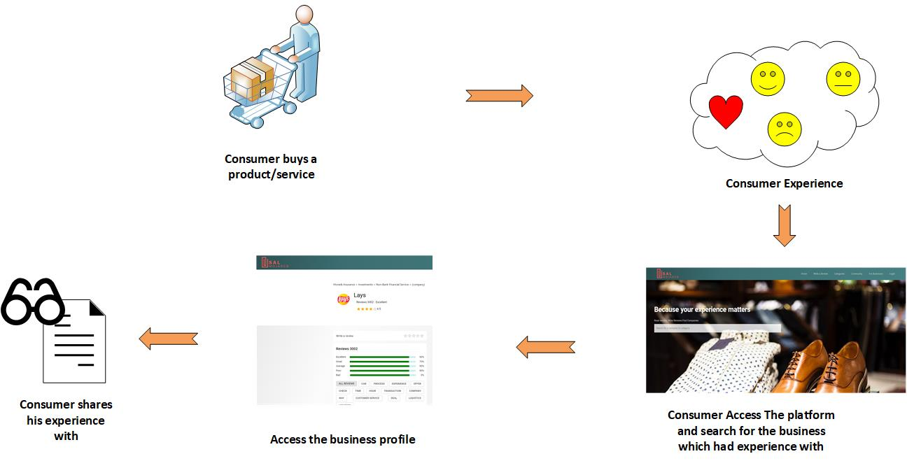
BUSINESS PROCESS
1.Consumers review process
SAL MDJAREB is free based-platform for all the consumers who want to access any business profile page and share their opinion publicly about their offering, however, consumers need to create their profile page to track their profile history and implement a verification system.

Slide 15
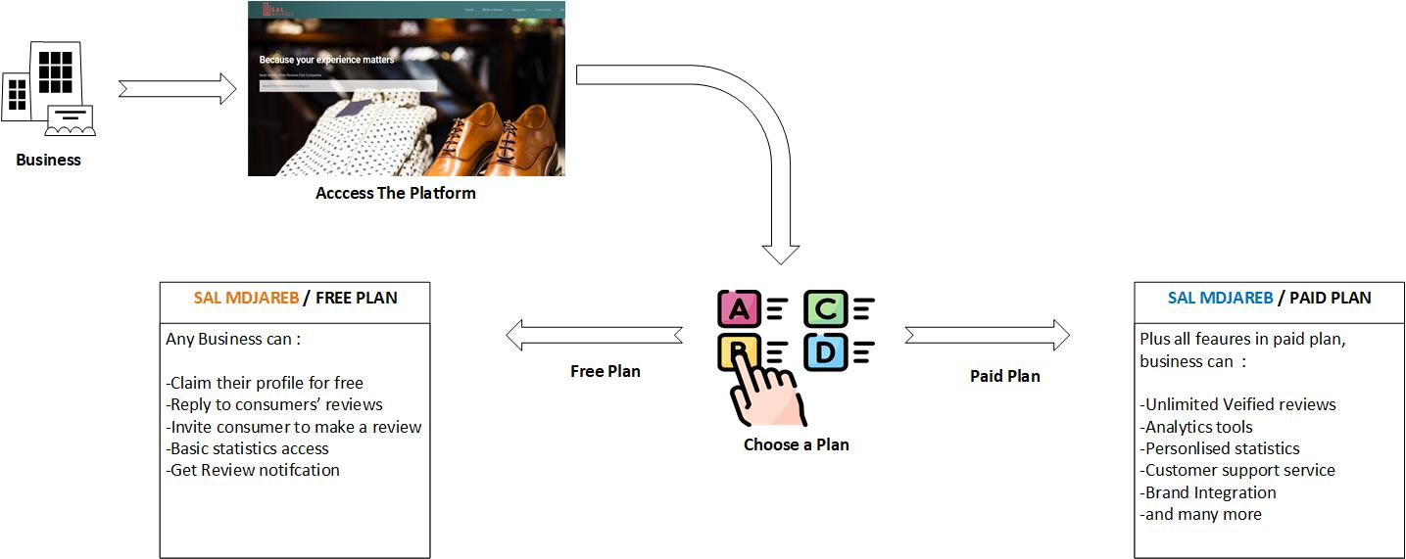
BUSINESS PROCESS
As for Business, we have two plans, free and paid , in free plan every business can claim their profile page and learn what consumers’ opinion about their products and services , besides, any business can invite its customers to leave review on its profile page on SAL MDJAREB, they can also reply on their customers.on other hand , paid plan can more sophisticated , we offer unlimited review access for companies , and let them show reviews on their website to win more business
2.Review Exploitation Process

Slide 16
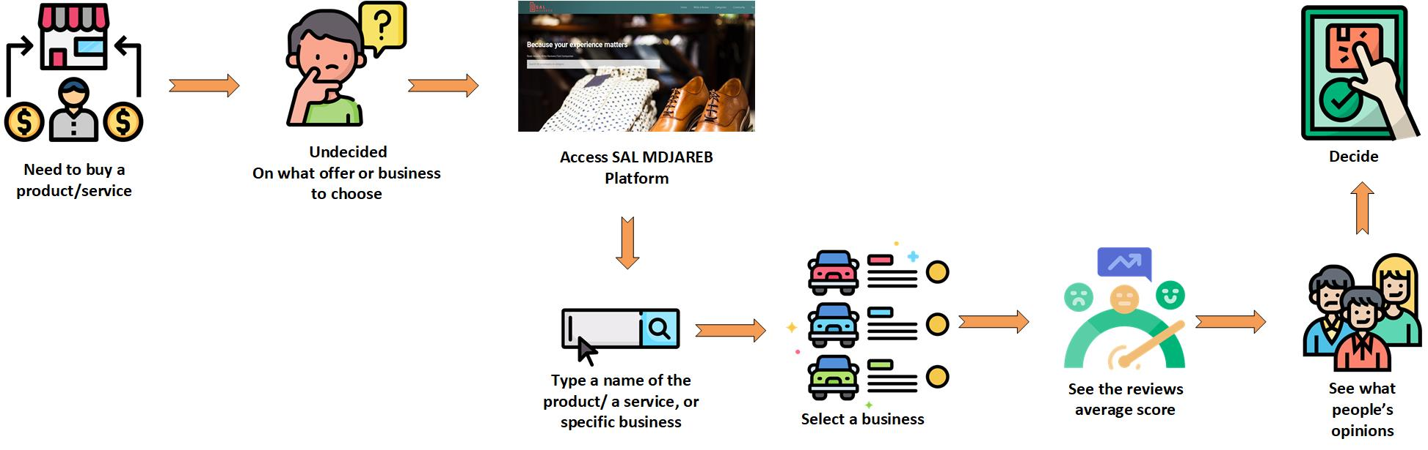
BUSINESS MODEL
SAL MDJAREB serves as s trust source of truth for the quality of the local offering.
any consumer ,before the decision phase, can access SAL MDJAREB platform to what people are saying about any specific product and service or even people opinion about a certain business.
3.Consumers’ Review Consulting

Slide 17
MARKETING STRATEGY

Slide 18
CONTEXT ANALYSIS

Slide 19
CONTEXTE-ANALYSIS Opportunities
O1:No similar startup existed before in algeria
O2:Attributing “Projet innovant” label by startup ministry for projects have not yet been created.
O3:Financial support by Algerian Startup Fund
O4:Algeria Venture, a place where a project will be accelerated
O5:a broader breakdown in trust in society and online institutions, and the desperate need for companies to win that consumer trust
O6:Raisen feeling of untrust and dissatisfaction from the quality of the products and services offered by local business
O7:researchers have investigated the economic impact of online reviews,finding that online reviews influence consumer choices and impact companies’ bottom lines in a variety of industries (Clemons et al. 2006, Chevalier and Mayzlin 2006, Ye et al. 2009,Zhu and Zhang 2010).
O8:The Algerian Market full OF skillful professional content creators

Slide 20
CONTEXTE-ANALYSIS Threats
T1:Using brand’s name and logo publically to be a subject of criticism is not allowed in algeria (solution: study the risk that firms may reject your proposition,show them the benefits ,and don’t talk about rating comparison between their counterparts,the risk here is rejection)
T2:Small business feels hostage by yelp because its blatant downplay filtering new customer review (solution: build a team of independent developers chosen by….)
T3:Weak Consumers Engagement (cultural and educational barriers)
T4:Weak companies’ engagement (do local companies really care about customers reviews?!)

Slide 21
CONTEXTE-ANALYSIS Threats
T5:social influence and reviewer self-selection may lead to systematic biases and temporal dynamics in review valence
T6:The popularity of online review platforms can provide businesses with extra incentives to engage in review manipulation
T7:Low Website/App Traffic risks to fail the project
T8:A decline in platform’s trustworthiness (MC:Quality inspector)
T9:Low Internet Speed
T10:Businesses would be afraid to the idea of being reviewed side to side to other stronger businesses.

Slide 22
CONTEXTE-ANALYSIS Threats
T11:Fake reviews
MC: implement Algorithms that sends feedbacks to consumers to validate or deny the fake review
T12: Neutrality, are we neutral?
MC:development team should be neutral,independant, and unknown

Slide 23
CONTEXTE-ANALYSIS Strengths

Slide 24
CONTEXTE-ANALYSIS Weaknesses
W1:financial support
W2:no Workspace

Slide 25
WHAT WE OFFER?

Slide 26
OUR PRODUCTS
The revenue model of SAL MDJAREB is very simple. SAL MDJAREB does not charge any consumer for browsing. The browsing is made free of cost.however, The revenue streamflow can be generated from the businesses through the following services, namely:
Premium subscription
Advertisements
Detailed Analysis
Brand integration
Custom surveys
These are just few services that can generate revenue for our business.

Slide 27
PROMOTIONAL STRATEGY

Slide 28
MARKETING AND PROMOTION STRATEGIES
SAL MADJAREB project is the first of its kind in Algeria. it will target both consumers and businesses by different promotional strategies with the aim to fulfill the need of both parties.
Our main promotional focus in the next 2 years will be centered around the following objectives:
Positioning SAL MDJAREB as an ideal solution for a source of trust ;
Increase SAL MDJAREB brand’s Awareness;

Slide 29
MARKETING AND PROMOTION STRATEGIES
# | PROMOTIONAL OBJECTIVES | PROMOTIONAL STRATEGIES | TARGET
1 | Positioning SAL MDJAREB as an ideal solution for a source of trust | Problem and Solution Positioning. when it comes to purchasing decisions, reviews offer valuable guidance and a source of truth for consumers who have already used the product or the service.it helps them to avoid risks, gives insights, and indicates quality.Also, offer valuable feedback for businesses to improve the quality of their offering, besides being a marketing tool for more brand exposure. Quality Positioning. Consumers want to know your products and services are reliable, durable, and worth the cost. Value Positioning. Generally, people read reviews to avoid the risk of bad purchasing ,also to decide on which business they can put trust, and this is when reviews offer high value. Celebrity-Driven Positioning. | Consumers Business

Slide 30
MARKETING AND PROMOTION STRATEGIES
# | PROMOTIONAL OBJECTIVES | PROMOTIONAL STRATEGIES | TARGET
2 | Increase SAL MDJAREB brand’s Awareness | Guest Blogs Adsense Advertisement display Fairies Search Engine Marketing improved Content Marketing through social media Develop Partnership with notable organisation like APOCE Aligning value proposition With the Customers’ Needs Offer a Freemium /Free Service Harness Social Proof to Persuade More People | Local Business Consumers

Slide 31
PRICING STRATEGY

Slide 32
PRICING STRATEGY
While pricing strategy should be set to maximize profit and revenue,our financial objectives will not reach their goals until customers (businesses) perceive the high value of our services.
We will use the Freemium strategy with a basic version of our platform services with free trials and limited memberships to enable customers to take a peek into SAL MDJAREB’s full functionality -premium version- and also build trust with a potential customer before purchase.
This strategy will allow us to populate our platform and get access to valuable informations that our customers will provide when creating their profile on our platform.

Slide 33
SALES STRATEGY

Slide 34
SALES AND MARKETING PLAN
OBJECTIVE | TARGET | STRATEGIES | TACTICS/MESSAGES | KPI
Increase platform’s traffic to 1 000 000 visitors by month within 2 years. | Consumers | Expose the problem: to achieve the consumers' consensus around the issue of the poor quality of the local offering by driving traffic from social media into the platform. Come up with the solution : SAL MDJAREB PLATFORM Engage consumers: by encouraging them to share their experience through SALMADJREB’s platform. | crowd psychology techniques. run facebook ads targeted for large public. Message :”should be show the benefits how reviews can help improve quality” Channels: “social media,Fairies,Vblogs,”. | platform traffic
Get at least 30% of the local businesses as premium subscribers within 2 years | Businesses | Offer a basic and free version of the of the profile for all businesses Offer premium service for free for limited time (for example : detailed analysis service) | Message: “should show all the benefits that reviews can help improve their revenue ” Channels: “social media, fairies, conférence,door-tooor, cooperating with independent organisation like APOCE..etc; | Number of premium subscribers

Slide 35
COMPETITION!

Slide 36
COMPETITIVE ANALYSIS
Since this idea of review website is completely brand new startup in algeria, there is no need to perform this analysis.

Slide 37
PROTOTYPE SNAPSHOTS (PC Version)

Slide 38
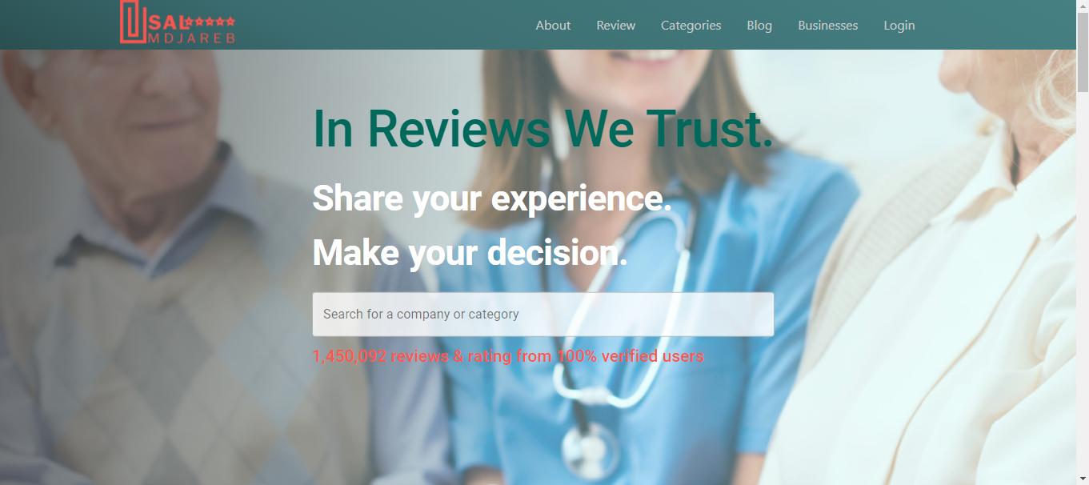
Home Page

Slide 39
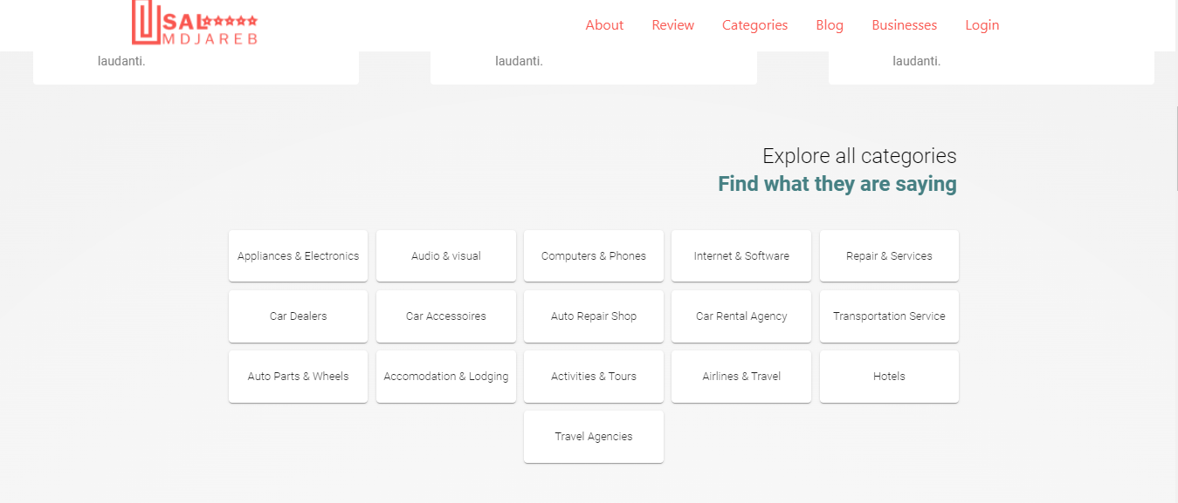
BUSINESS CATEGORIES

Slide 40
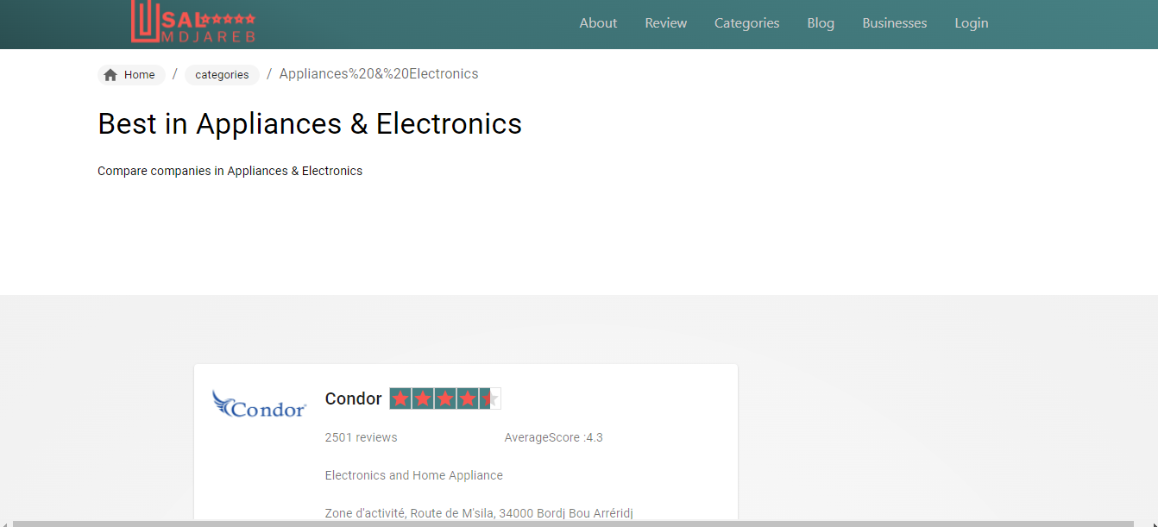
Demo:Appliances & Electronics

Slide 41
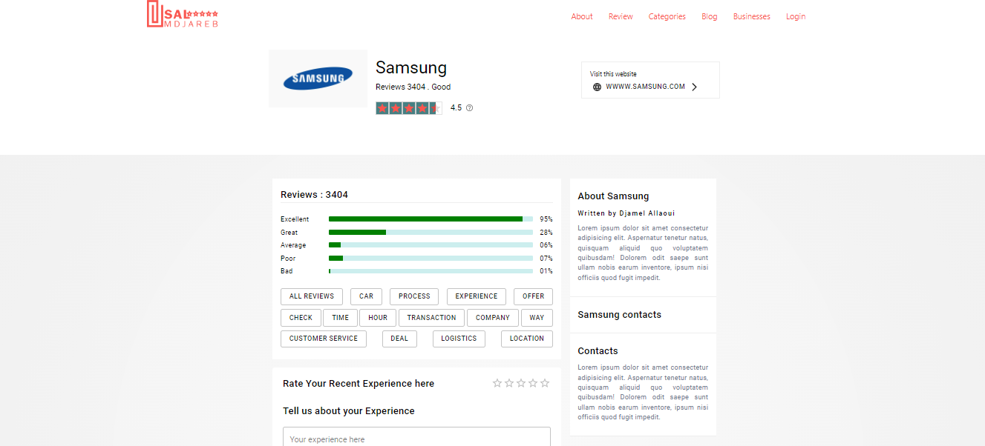
Demo:Business Profile Page

Slide 42
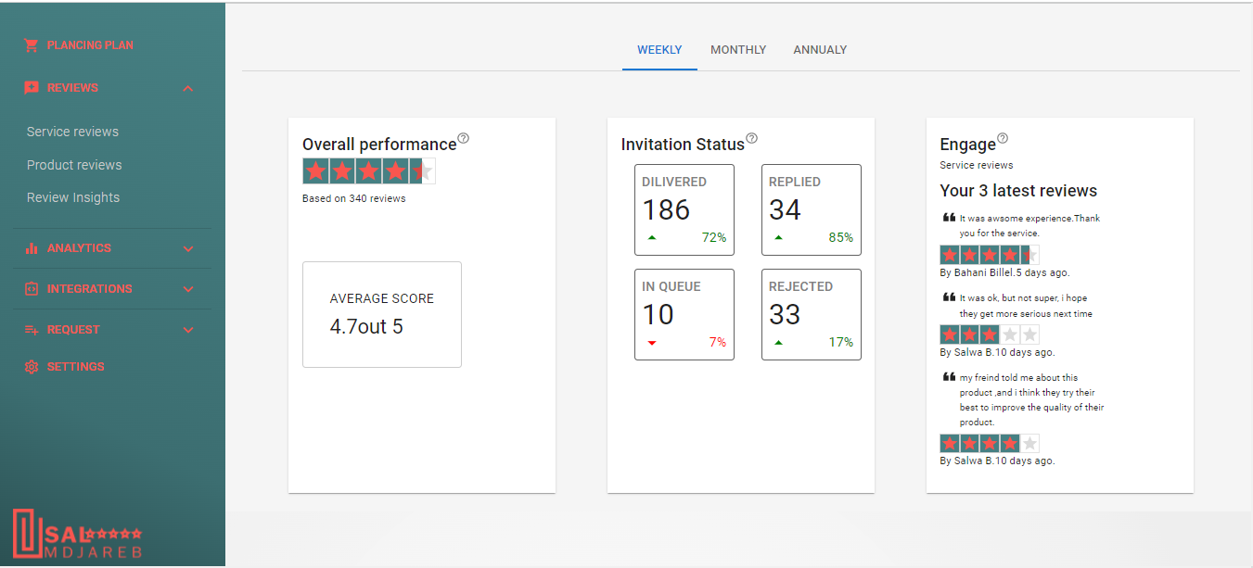
Business Analytics Dashboard Businesse→ Scroll to “Track your Business Metrics-Click “see the key Metrics”

Slide 43
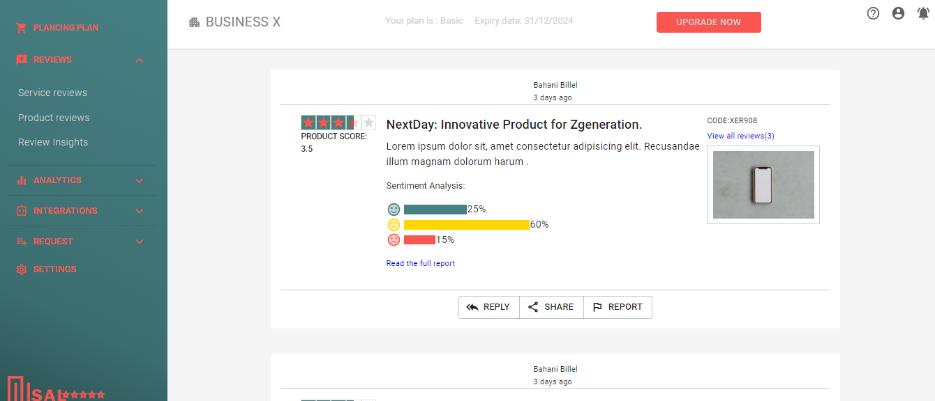
Business Analytics Dashboard Businesse→ Scroll to “Track your Business Metrics-Click “see the key Metrics”

Slide 44
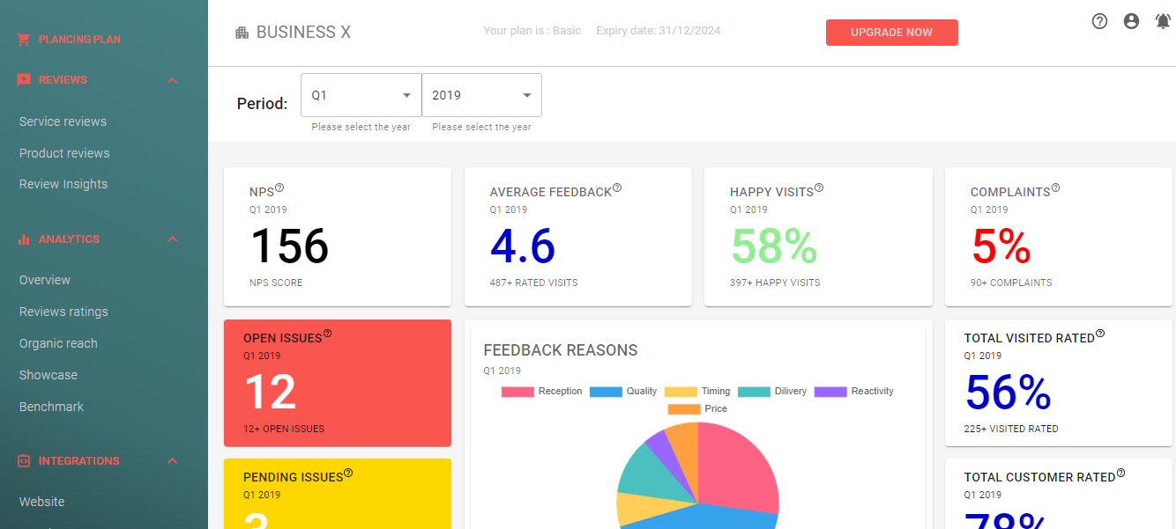
Business Analytics Dashboard Businesse→ Scroll to “Track your Business Metrics-Click “see the key Metrics”

Slide 45
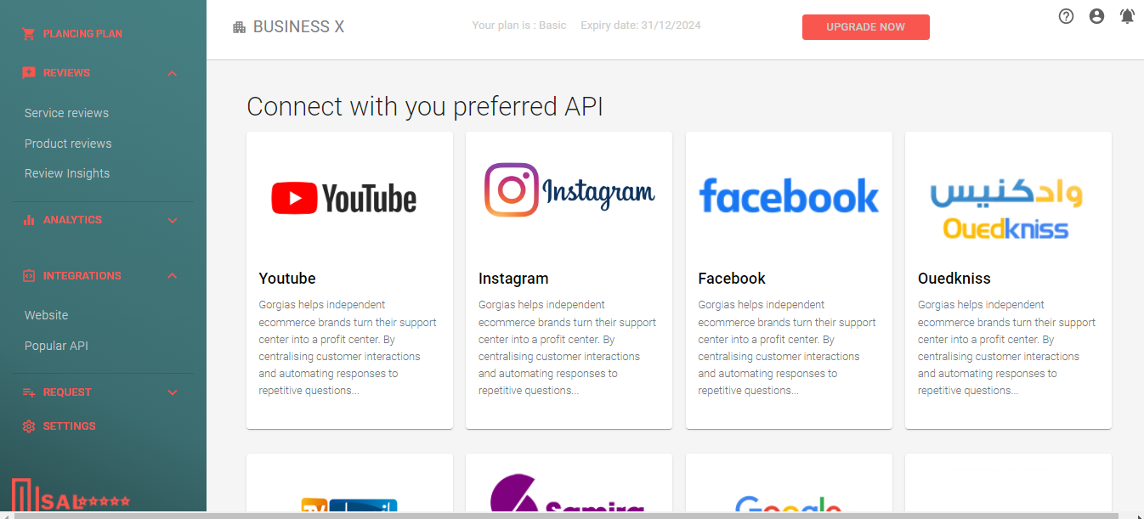
Business Analytics Dashboard Businesse→ Scroll to “Track your Business Metrics-Click “see the key Metrics”

